Slide 1

Can We Be Happier?
Facts and Myths

Slide 2


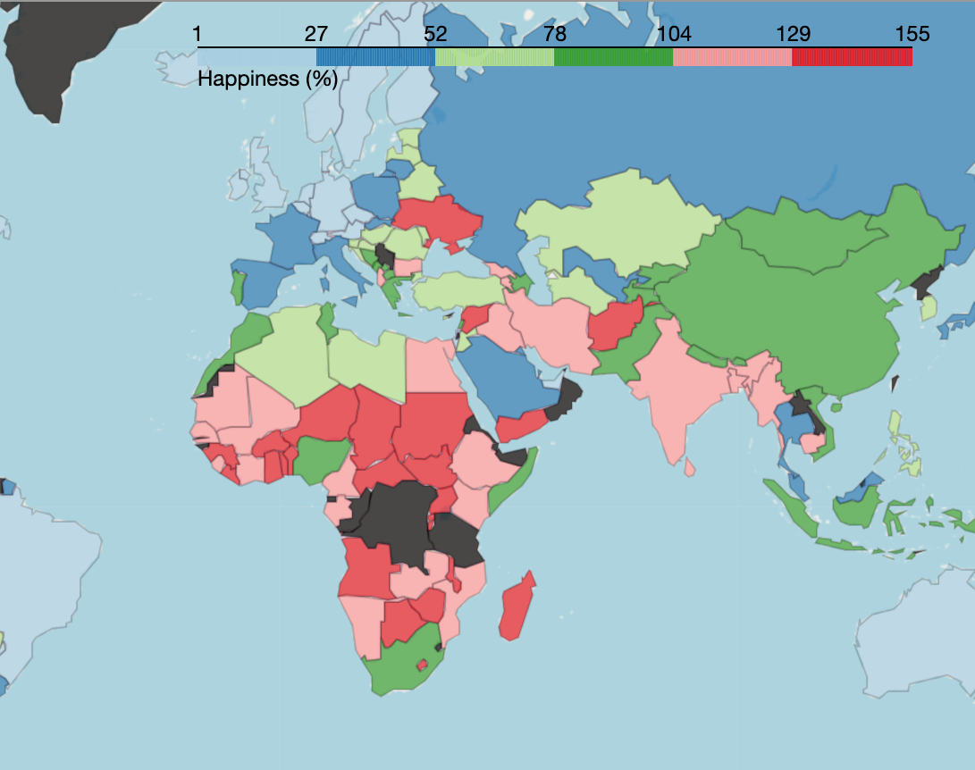
Happiness Index (or "Life ladder")
Did you know countries are ranked each year based on a Happiness Index? This index rates the happiness of countries on a scale from 0 to 10.
Today, we are going to face some facts and break some myths about Happiness and what we may think can make us happy.

Slide 3
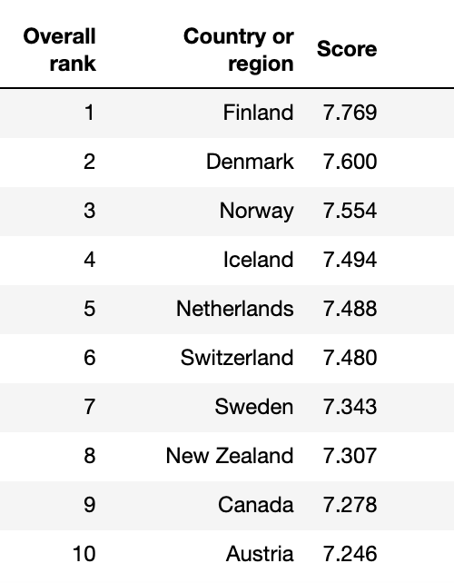
Top 10 Happiest Countries 2019
In 2019, the Gallup World Poll included Happiness Index data in 156 countries.
According to the Happiness Index of 2019, the happiest countries in the world are:

Slide 4
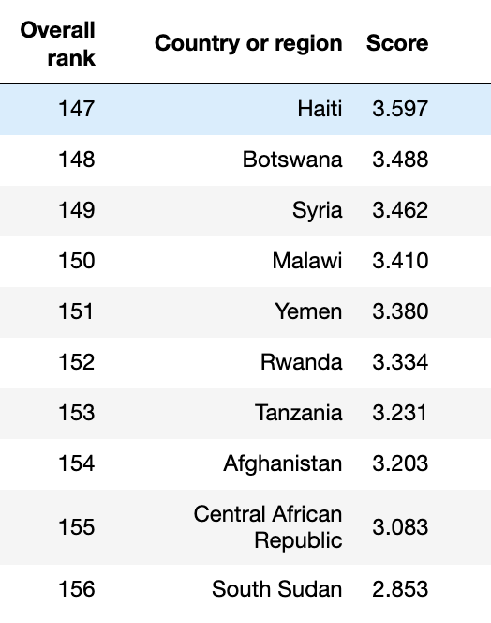
The 10 Unhappiest Countries 2019

Slide 5

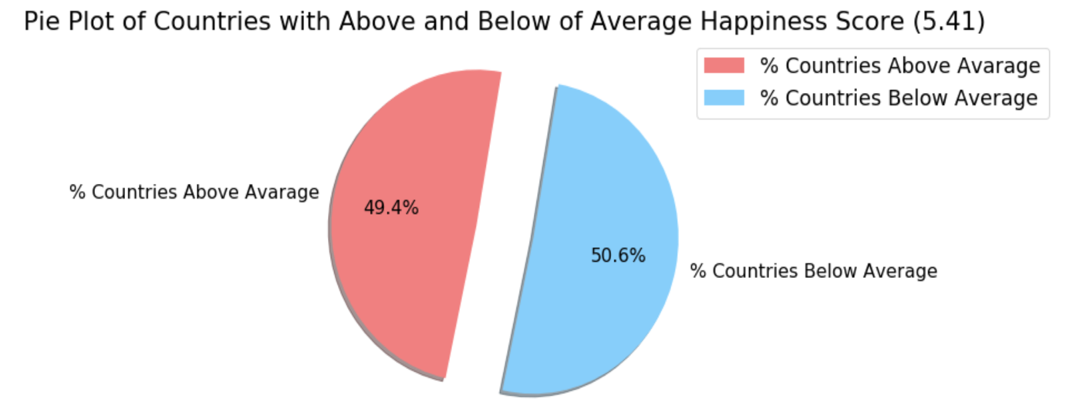
For your information, the average Happiness Index of all the 156 countries is 5.41 Less than 50% of all countries have Happiness Index above the average

Slide 6
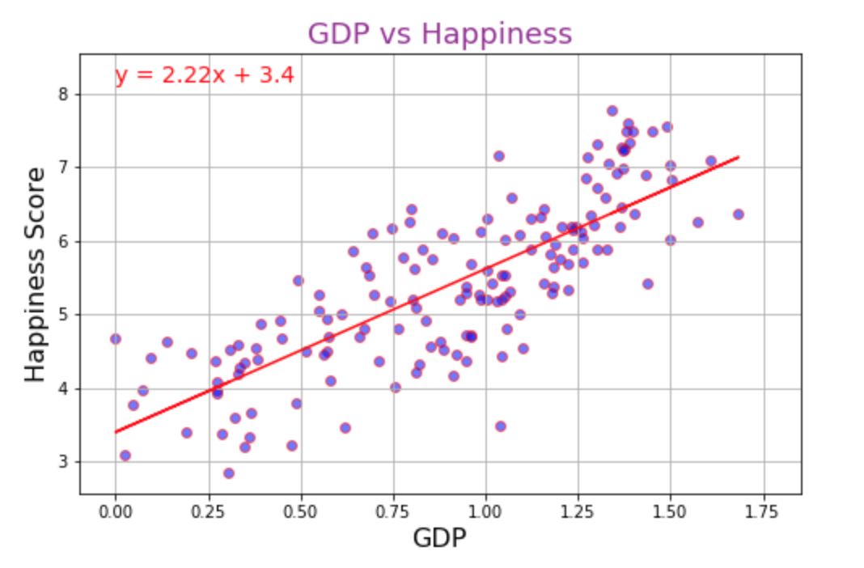
Money buys happiness up to a certain degree r-squared is: 0.794 p-value is: 4.3153e-35
GDP per capita
Gross Domestic Product - or GDP - is simply the value of all the goods and services a country produces on a yearly basis.
Divide the GDP by the total population of a country and you have the GDP per capita.
This is arguably the most accepted method of determining a country's level of wealth.
The wealth of a country is significantly correlated to its Happiness Index.

Slide 7

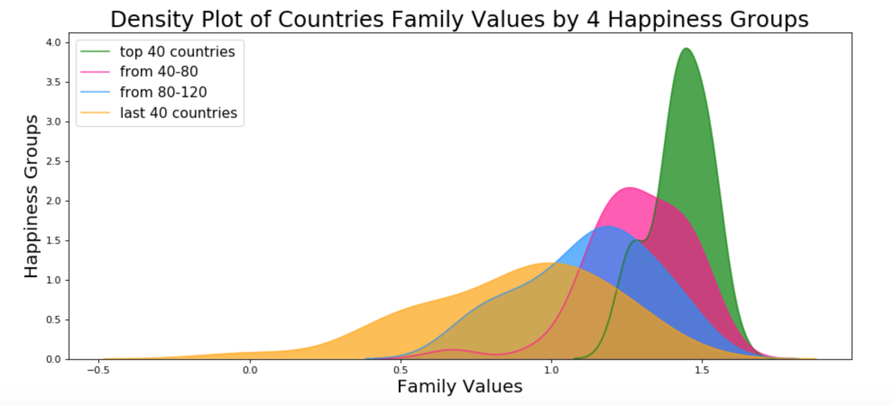
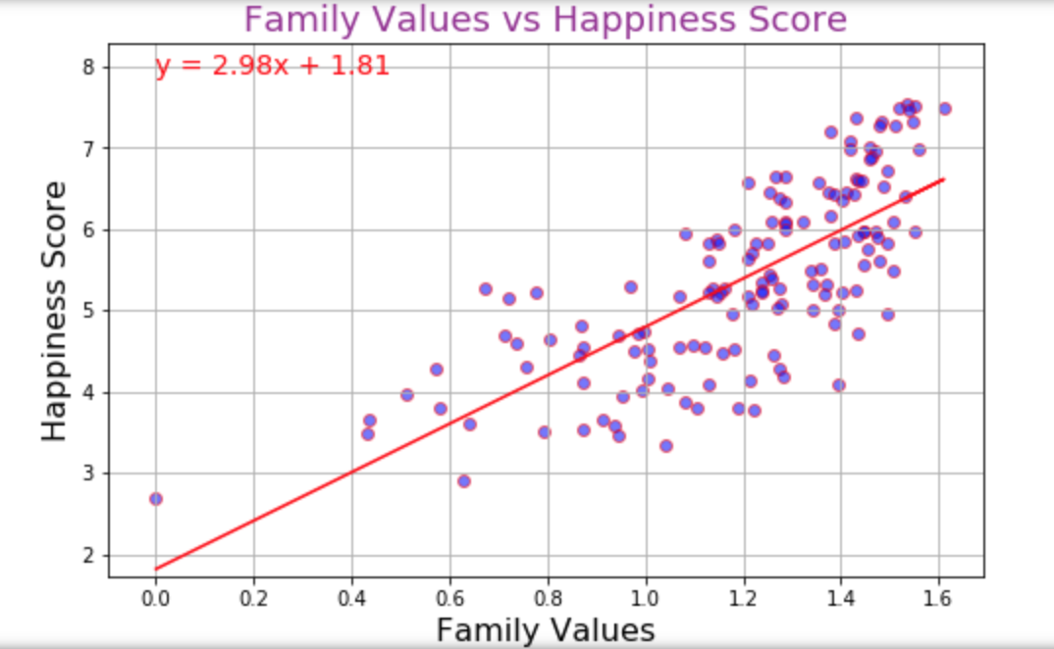
Family Values r-squared is: 0.742 p-value is: 8.109e-27
We divide all countries into 4 groups, based on the Happiness Index. The happiest countries are consistent with the highest family values.

Slide 8
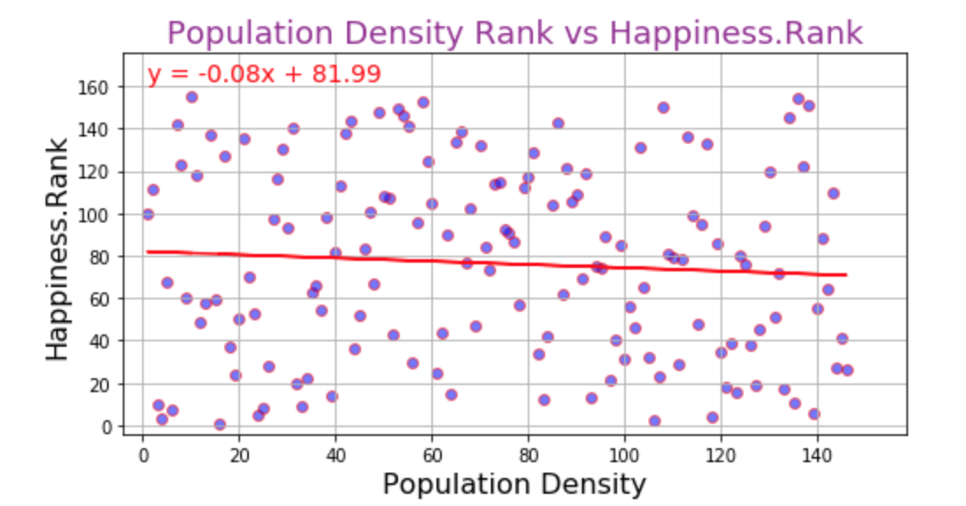
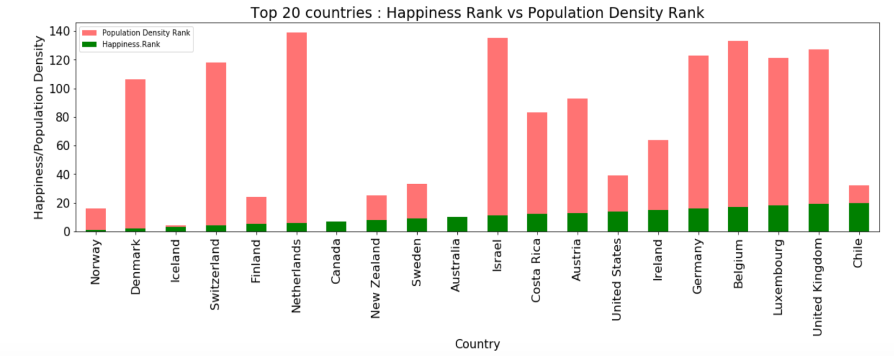
Population Density r-squared is: -0.073 p-value is: 0.382

Slide 9
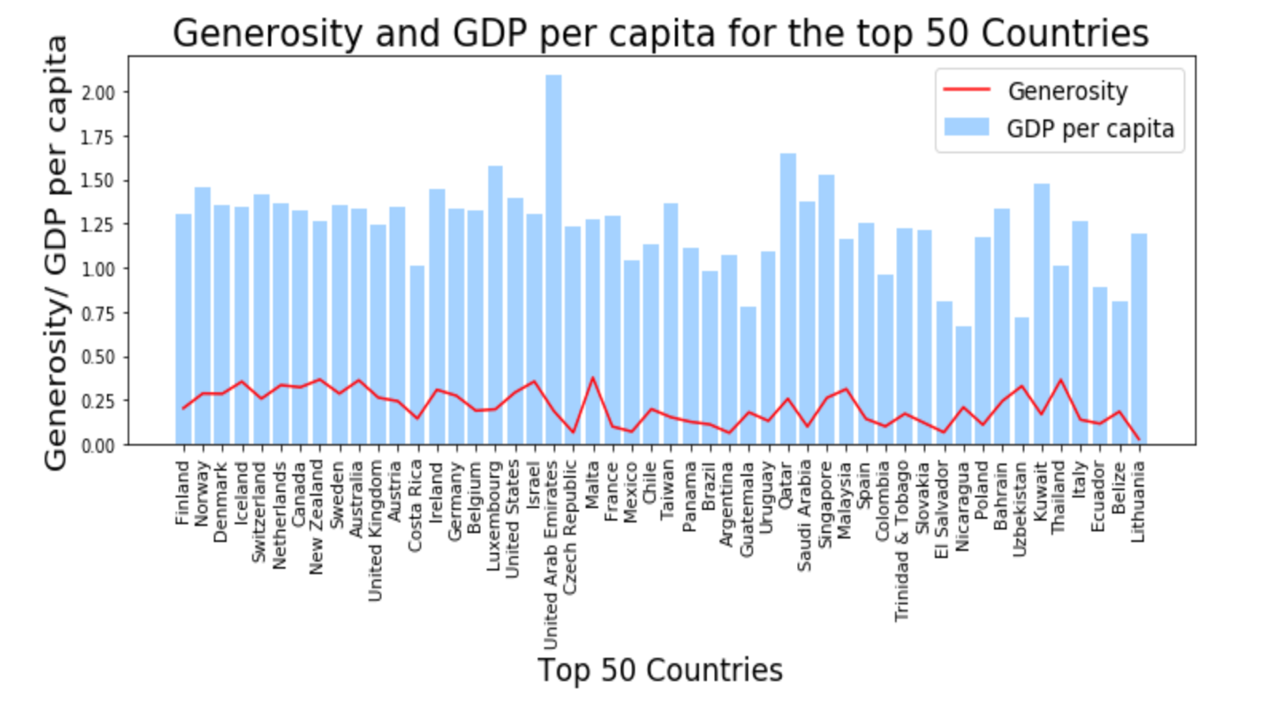
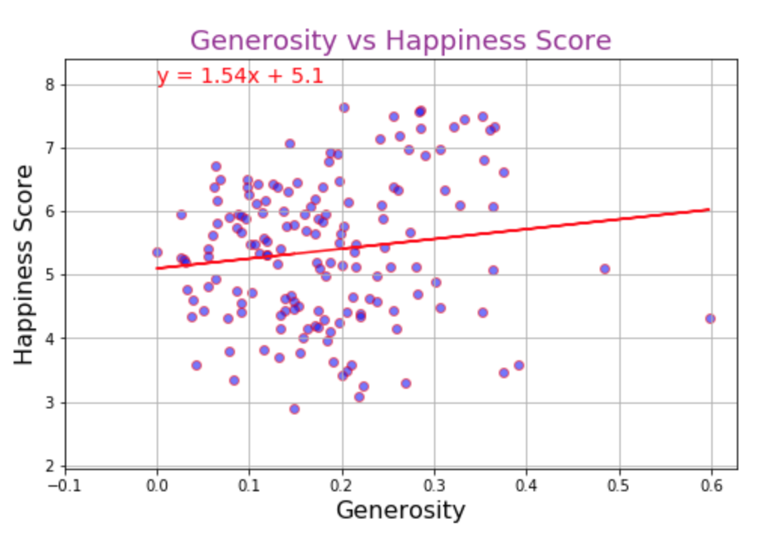
Generosity r-squared is: 0.136 p-value is: 0.091

Slide 10
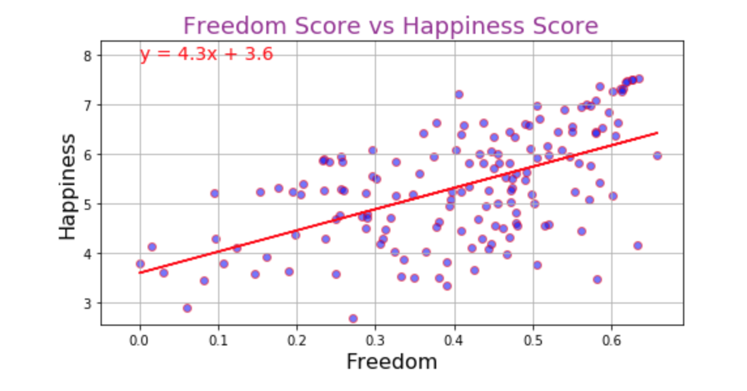
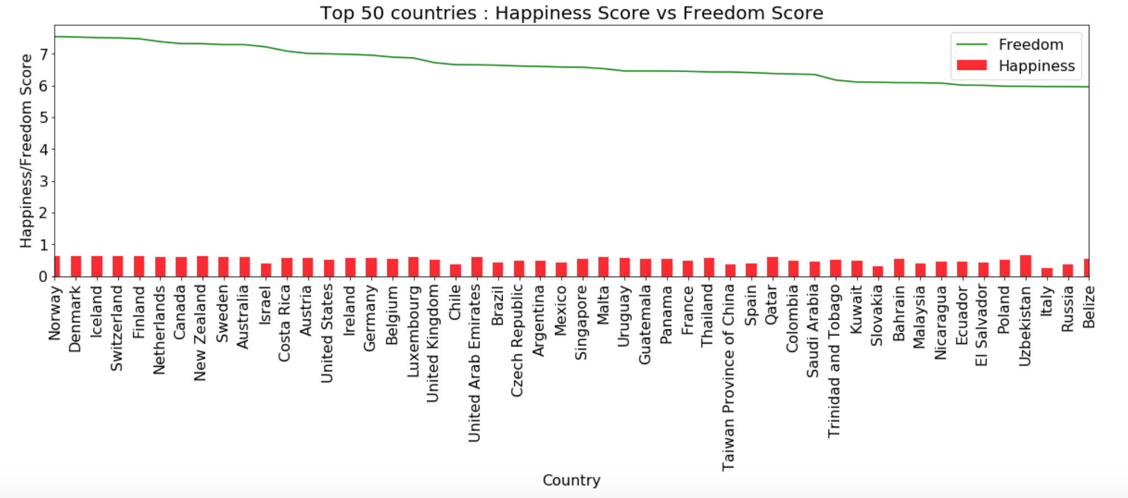
Freedom r-squared is: 0.570 p-value is: 9.6879e-15

Slide 11
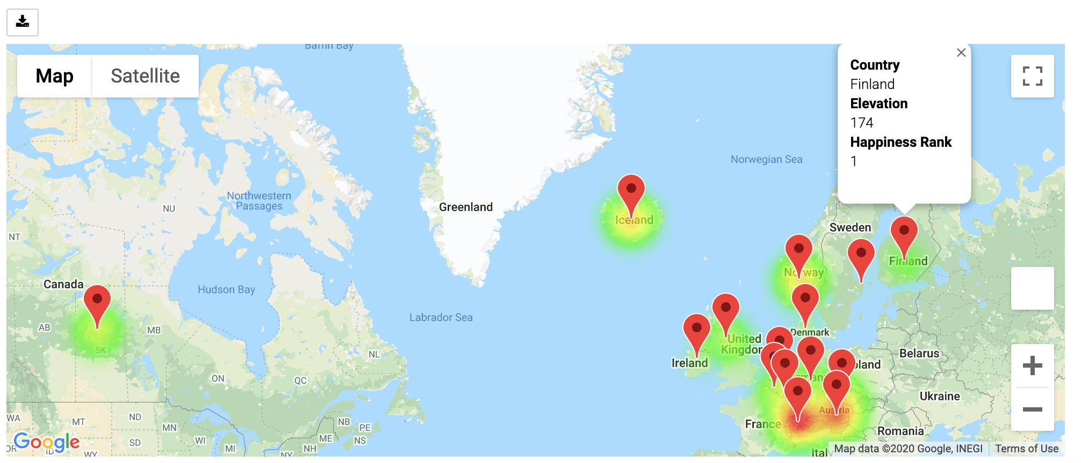
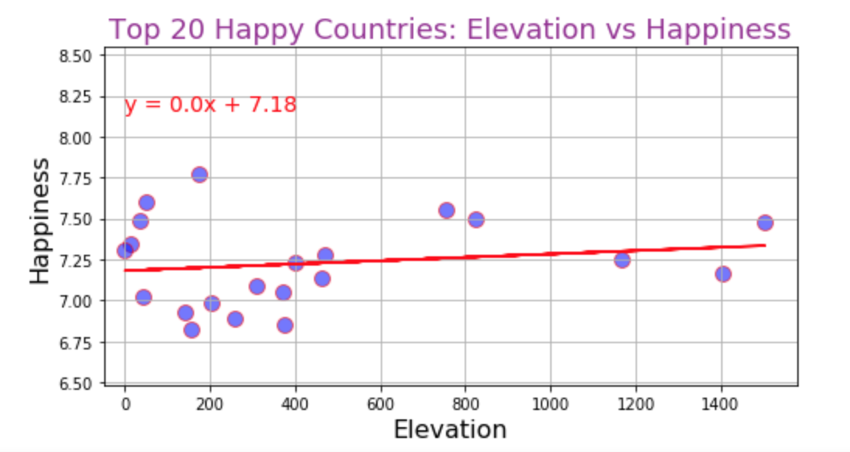
Elevation r-squared is: 0.1706 p-value is: 0.459

Slide 12



Sometimes We Are Just Happy!

